Slide 1


Slide 2
Our Vision
Our vision is empowered members taking collective action for safe, equitable workplaces and high-quality health care for all Ontarians.
Our Mission
Our mission at ONA is to defend the rights of and advocate for nurses and health-care professionals who care for the health of Ontarians.

Slide 3
ONA Fast Facts
68,000 ONA members
18,000 Nursing student affiliate members
63 Locals across Ontario
500+ ONA Bargaining Unit Presidents

Slide 4
ONA represents members in the following workplaces:
Hospitals.
Nursing Homes.
Homes for the Aged.
Public Health.
Home and Community Care Support Services.
Home Care.
Clinics.
Industry.
Family Health Teams.
Community Health Centres.

Slide 5
ONA members include:
Registered nurses.
Nurse practitioners.
Registered practical nurses.
Therapists- PT, OT, SLP, RT, Radiation therapists.
Medical Laboratory Technologists.
Pharmacy Technicians.
Social Workers.
Dietitians.
Medical Radiation Technologists.
And many more.

Slide 6
Your Union, Your Power
A union is formed when the employees decide they want to speak with one strong, collective voice. ONA is built and led by members’ needs and priorities.
Members are organized into more than 500 Bargaining Units in 60 Locals across Ontario. You elect your executives and representatives, who work with ONA staff to improve your working conditions and maintain your rights in the workplace.
They also link you and your colleagues with broader membership and the Board of Directors, bringing forth your concerns and building a strong province-wide network of support. We show up together. We fight for each other and for those who can’t fight for themselves.

Slide 7
YOUR LOCAL EXECUTIVE

Slide 8



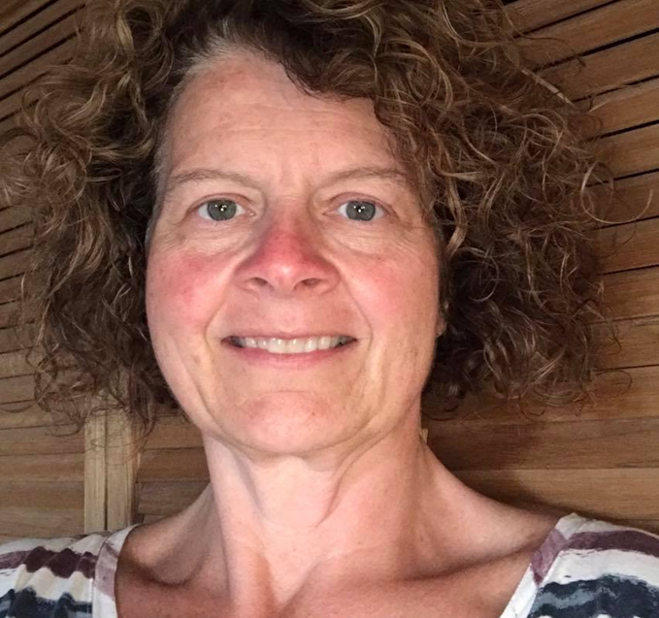

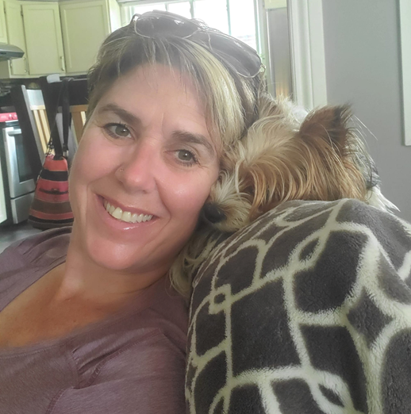

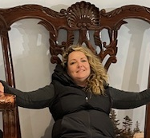



practiceColleen Kennedy
Professional
Tina Frappier
BUP
LC
Tammy Bourque
Grievances
BU Executive

Slide 9
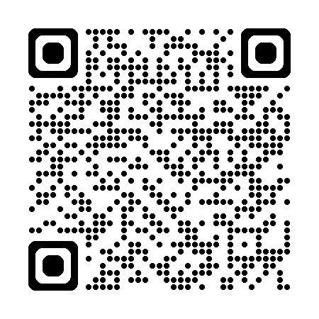
New member orientation ona.org

Slide 10
Because we are a nursing and health-care professionals’ union, all our resources are devoted to advancing and supporting the interests of registered nurses and health-care professionals. We provide expert services and professional representation to members, including:
  At the bargaining table negotiating collective agreements in which ONA leads Ontario’s health-care sector for wages.
  Litigating court cases that directly affect our members – including Bill 124, pay equity, and Workplace Safety and Insurance Appeals Tribunals – to achieve important wins that affect our members and all workers.
  Fighting for members’ workplace rights and managing their grievances and arbitrations.
  Representing members at licensing body hearings (such as the College of Nurses of Ontario, at coroners’ inquests and more).

Slide 11
Legal Expense Assistance Plan (LEAP)
Our LEAP Team can help with the following legal issues (certain terms and limitations apply):
  Complaints or reports to your regulator college about your professional practice and reports about health issues like substance use disorders and mental health disorders.
  Appeals of regulatory body decisions.
  Complaints and reports to the Information and Information and Privacy Commissioner
  Criminal investigations arising from a job-related incident.
  Coroner’s investigations and inquests.
  Advice if you’re called as a witness in a legal proceeding.
  Advice about long-term care inspections.

Slide 12
Union Dues
ONA membership dues are a flat rate – a set amount that you pay monthly through payroll deductions after your first collective agreement is ratified. You can deduct union dues from your taxable income (see your T4)
The collection of union dues is a democratic and transparent process, from start to finish. ONA members decide at our Biennial Conventions on the structure and amount of dues, along with how they are spent.
The services ONA provides are funded by the dues our members pay. Over the past several years, the costs of supporting our members have increased substantially. We have stepped up our work in fighting for our workplace rights, supporting anti-racism initiatives, bargaining and negotiations, litigating in courts including Bill 124, mobilizing and campaigns, professional practice issues, providing base long-term disability for members not covered by their employer, malpractice insurance, pay equity work, technology, IT supports and equipment, education, and so much more.
Despite rising costs and increased demand, ONA’s Local and provincial leadership are committed to ensuring there are no cutbacks to the core services and advocacy our members need and deserve.
Make sure to check your paystubs for errors and that dues are being deducted. If you are not paying dues, you do not get the benefits of our union and you will be held in arrears

Slide 13
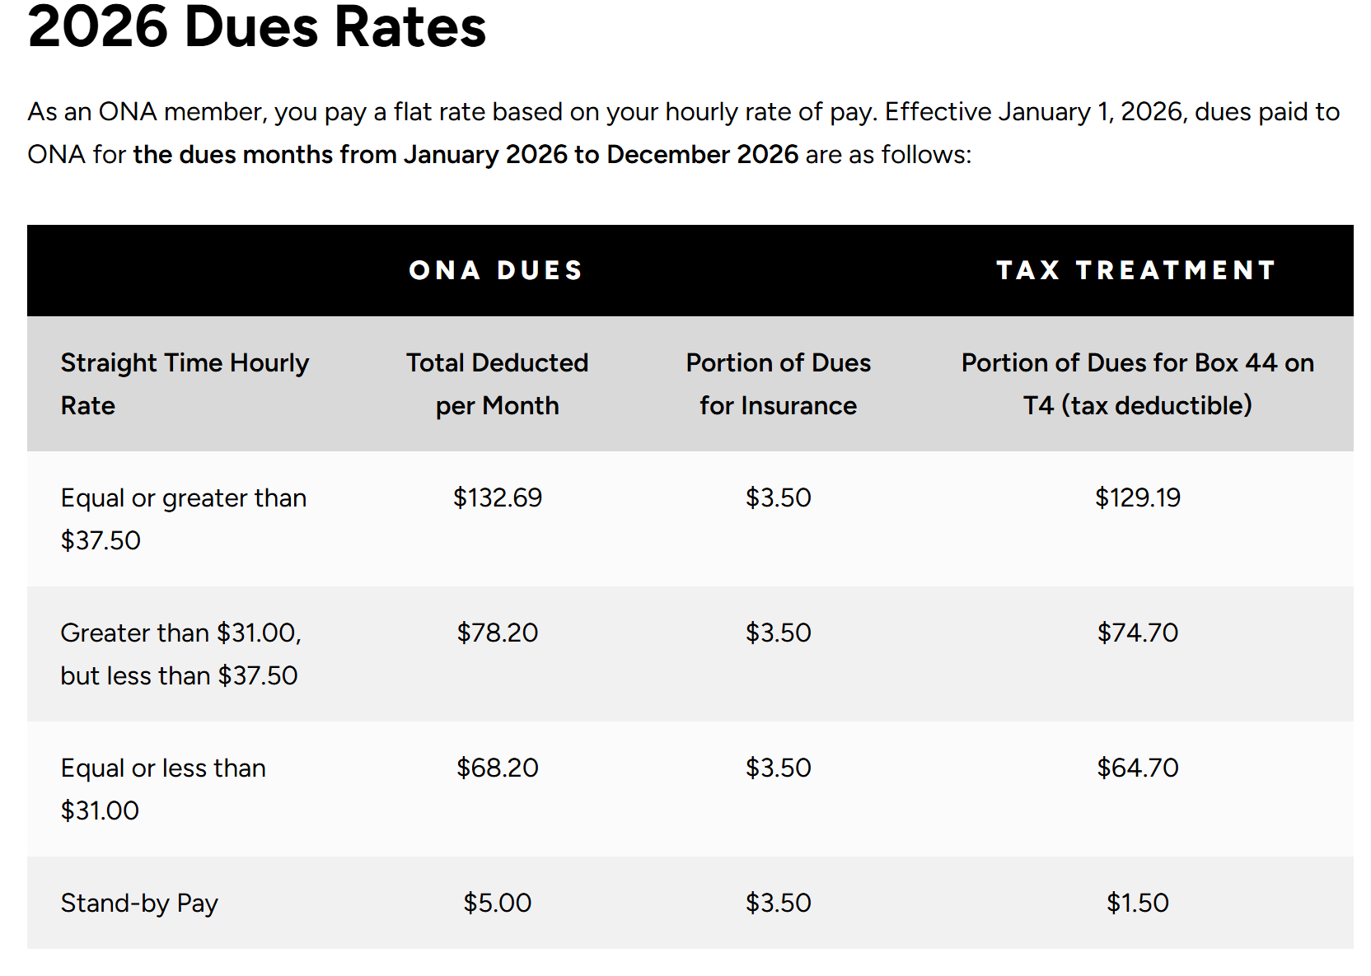
If you work for more than one ONA employer, you will be impacted by dual dues. ONA has a dual dues refund policy whereby you will automatically be reimbursed at the end of April if you have paid dues for greater than 12 times in a calendar year

Slide 14
Insurance and Benefits
As an ONA member, you have access to ONA’s benefits program through Johnson Insurance. Your ONA Base Plan is covered through your union dues ($2.50 per month), and includes:
Critical Illness Coverage (CI)
  ONA members under the age of 75 may be eligible for a lump sum benefit payment of $3,750 for part-time/casual members or $7,500 for full-time members without any additional premium if diagnosed with life threatening cancer, stroke, heart attack, benign brain tumour, coronary artery bypass surgery, aortic surgery, occupational HIV or Hepatitis C.
Long Term Disability Coverage (LTD)
  Base Plan disability income protection is the first step towards helping to protect one of your most valuable assets – your income! If you are under the age of 65 and you do not have employer-sponsored LTD coverage, you are covered and may be eligible for $250 of monthly LTD benefit, should you become disabled due to illness or injury.

Slide 15
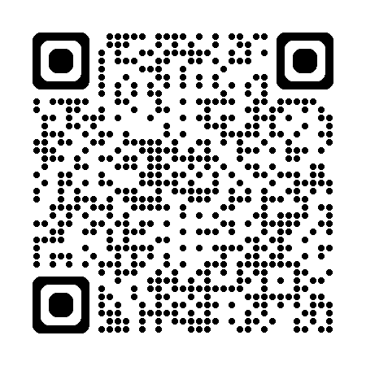
Access ONA – Member Portal
ONA has created an easy-to-use online portal for our members. Access ONA is a convenient and secure one-stop shop, where you can:
  Maintain your personal records and contact information.
  View your current jobs and learn about your Bargaining Unit.
  Submit requests for documentation.
  View the ONA Workshop Calendar, register for education, and print certificates for completed courses.
  Access member-exclusive forms, resources and more.

Slide 16
We use social media to keep members and stakeholders informed of:
  ONA news, meetings and events.
  Ongoing campaigns and political action.
  Discounts and promotions available to ONA members.
  New publications, reports and submissions to government.
  and much more!
Follow us on your favourite social media channels for the most up-to-date news and information that affects you and your colleagues.
Facebook page ONA Local 13 Private group. Must answer questions to be approved

Slide 17
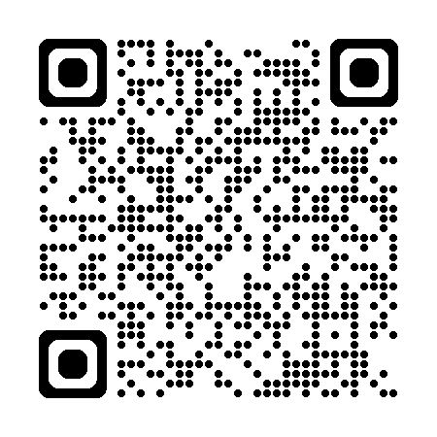
  Facebook Nursing

Slide 18
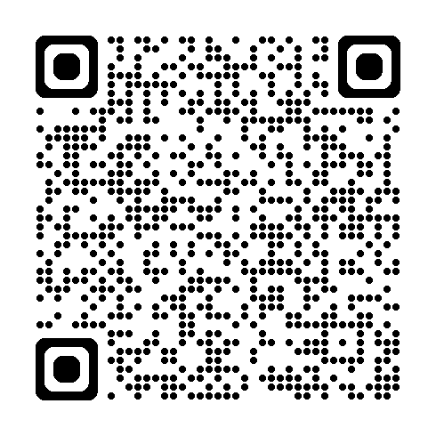
QR CODE FOR CENTRAL COLLECTIVE AGREEMENT
QR CODE FOR CENTRAL COLLECTIVE AGREEMENT

Slide 19
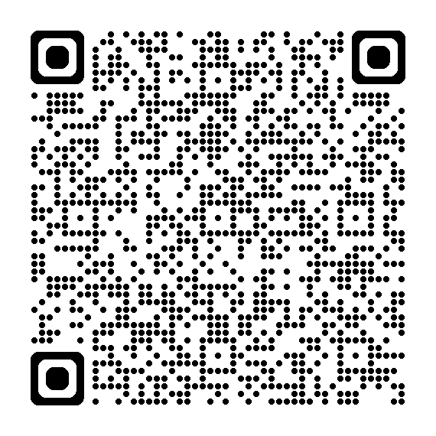
Nurses Local CollectiveOONA13
NURSES LOCAL
AGREEMENT Agreement

Slide 20
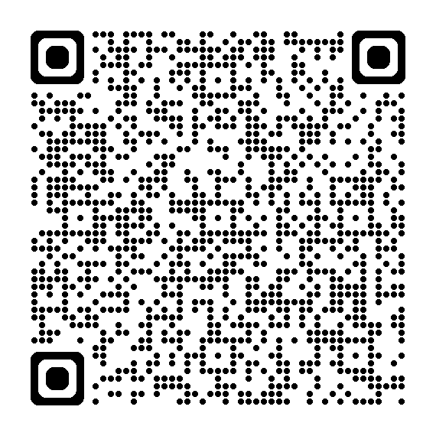
WEBSITE
https://local13.onalocal.org/

Slide 21
Enroll in HOOPP immediately – well funded pension plan
If you are called to a meeting with your Manager, you are entitled to Union representation
Your Union negotiates agreements with the hospital – before signing any other agreements, notify the Union first
If you are off on sick leave, notify your V.P. of Human Rights and Equity. They can help you navigate your paperwork and assist in your return-to-work plans
If you feel there is a violation of your Collective Agreement, notify your V.P. Grievances
If you feel that you are not able to fulfill your obligations set out by your College, fill out a workload report form and notify your V.P. of Professional Practice

Slide 22
 | ONA Nursing
PT (not in HOOP) | 14% in lieu of benefits
PT (enrolled in HOOP) | 10% in lieu of benefits
Credit for past experience | Has to be put in writing at time of hire (19.05)
1 year experience (PT)/(FT) | 1500 hours/Hire date

Slide 23


